Slide 1

NF06_EN - Friday Group 7
E-commerce Delivery Management System in C
Anish Patni
Lyudmil Apostolov
Krisha Devannavar
anish_ashwin.patni@utt.fr
krisha.devannavar@utt.fr
lyudmil.apostolov@utt.fr
‹#›

Slide 2
What the system does
Customer browse a product catalog loaded from a CSV file, build a cart & place orders with a priority level that can be chosen
Administrators process deliveries using a priority scheduling rule and track total revenue and completed deliveries
All orders are managed in memory using two priority queues and a delivery history is saved to a daily log file
‹#›

Slide 3



Customer Profile
Administrator Profile
Data Engine
Enables users to browse category-specific products, manage an in-memory shopping cart (with live quantity editing), and place orders. Note: Cart state is stack-allocated and resets when exiting customer mode
A secure portal to manage automated scheduling, view real-time revenue analytics, handle order cancellations, and export daily audit reports.
Hybrid storage model using a flat, statically-allocated array for the product catalogue (max 100 items) and dynamic intrusive linked lists for live order queues
‹#›

Slide 4
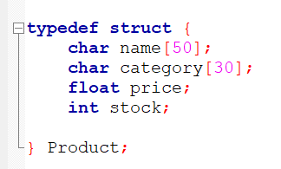
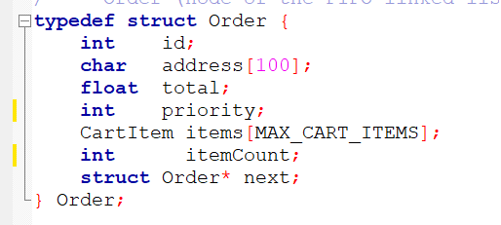
Data structures
struct Product
struct Order
Fixed-size array for O(1) access. Stores critical catalog metadata including pricing, categorization, and quantity-based availability.
Dynamic linked list nodes that form the backbone of the FIFO delivery queues. Captures a complete snapshot of the customer's cart. Two separate queues: one for priority 1, one for priority 2
‹#›

Slide 5
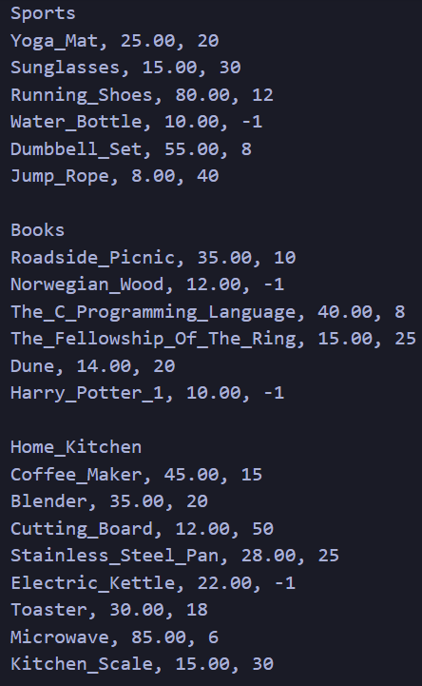
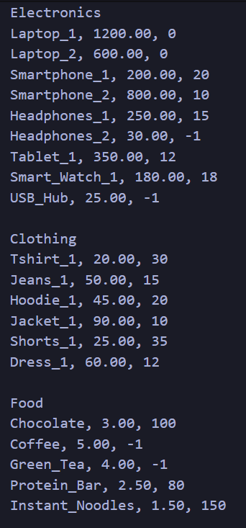
Data Persistence Strategy
Single-Point Load/Save
To ensure high performance, products.csv is read once at startup into memory. All updates occur in RAM and are flushed back to disk upon program exit.
Incremental Auditing
Administrative actions are appended immediately to logs/admin_log.txt. Successful deliveries are appended directly to the daily history file (history/DD-MM-YYYY.txt), ensuring zero loss of operational logs
‹#›

Slide 6
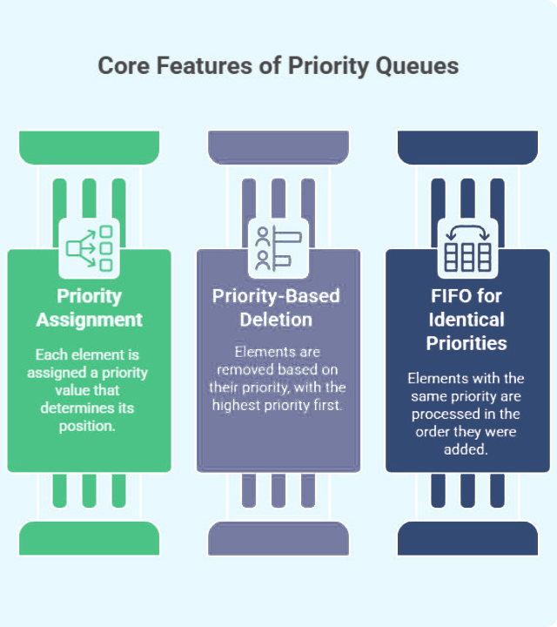
Priority Queue Logic
Our system implements two distinct FIFO (First-In, First-Out) linked lists to separate urgent requirements from standard orders.
The queue architecture ensures that "High Priority" orders are grouped together for optimized scheduling without permanently starving standard requests.
‹#›

Slide 7
Weighted Scheduling Rule
2
1
:
HIGH PRIORITY
NORMAL PRIORITY
The scheduler operates in cycles: processing 2 high-priority orders for every 1 normal-priority order. This prevents bottlenecking in the standard queue while honoring service level agreements for premium deliveries.
‹#›

Slide 8
Customer Workflow
Build Cart
Prioritize
Select quantity with automated stock availability checks.
Choose between High (Queue 1) and Normal (Queue 2) delivery.
Browse
Edit Cart
Checkout
Enter address; validation checks format (min 10 chars). In-memory stock deducted via updateStock(), queue gets appended, and the cart cleared ONLY on successful placement
Load products from memory and browse by specific category headers.
Edit Quantity: Sub-menu allows live updating of item quantities or entering 0 to remove an item in place, with immediate stock verification

Slide 9
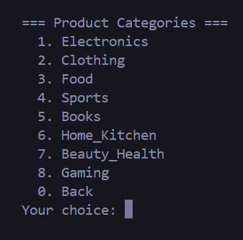
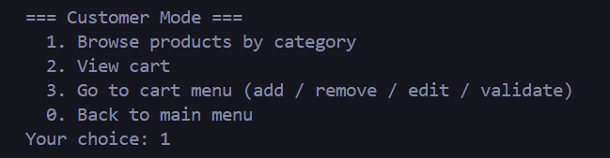
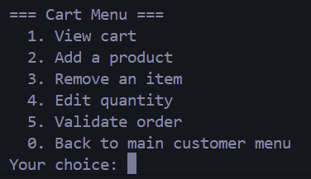
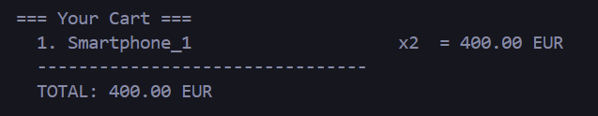
Output Snapshots

Slide 10



Administrator Control Panel
Process Deliveries
Live Statistics
Order Cancellation
Live Catalogue Management
Trigger scheduling cycles that dequeue orders, update history files, and free system memory.
Monitor real-time system performance including total deliveries, total revenue, and average order value.
Efficiently remove orders by ID from any point in the queue while automatically restoring in-memory stock.
Enables administrators to restock items, dynamically inject new products using safe string inputs (fgets), or discontinue items by setting stock to 0 without invalidating pending order references.
‹#›

Slide 11
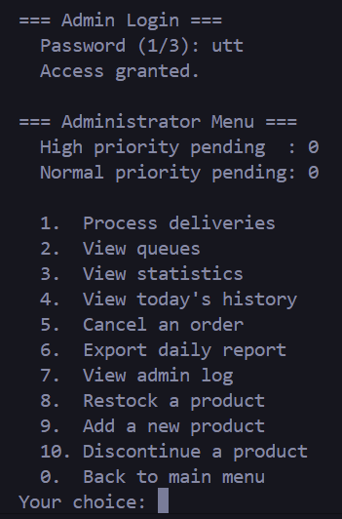
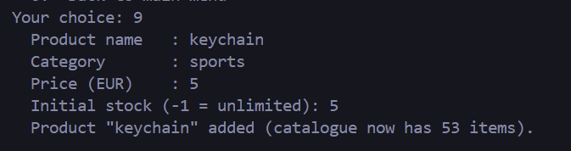

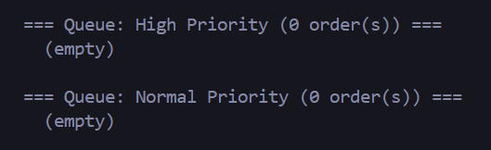
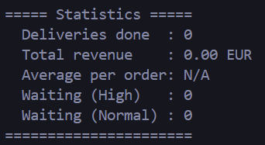
Admin Panel Output Snapshots

Slide 12
Stock Management Policy
Stock Value | Status | Logic Applied
-1 | Unlimited | Bypasses stock decrement logic during order validation.
0 | Unavailable | Marked as [UNAVAILABLE] in the catalog; cannot be added to cart.
> 0 | Limited | Limited supply. Checked at add-to-cart time, then formally deducted using the centralized updateStock() function only when the checkout sequence successfully completes
Restoration | Automatic | Automatic Restoration: When an order is removed by the admin, the system reads the embedded items[]snapshot inside that specific Order struct to precisely credit back quantities to the core catalogue array

Slide 13

Auditing & Reporting
Daily History: Every successful delivery writes a structured line string formatted as: Order ID | Address | Total EUR into a date-stamped file (history/DD-MM-YYYY.txt)
Formatted Reports: Export functionality generates structured daily summaries in the reports/ folder.
Admin Log: Persistent audit trail of all login attempts and management actions.
Data Segregation: Logical separation of data, logs, and history for better file management.
‹#›

Slide 14


Technical Decisions
Modularity: Decoupled architecture utilizing centralized helper modules (e.g., utils.c for flushInput) to eliminate duplicate code blocks across profiles
Efficiency: O(1) lookups using a flat array layout to handle a fixed-capacity catalogue (max 100 products), avoiding dynamic realloc overhead and structural complexity
Dynamic Scaling: Intrusive singly-linked list implementations embed pointers directly within records, cutting heap-allocation requests in half per order.

Slide 15
Conclusion
Robust Architecture: Successfully built a modular, dual-profile CLI application in C that isolates the implementations of product, order, customer, and administrator models.
Algorithmic Integrity: Implemented an exact First-In, First-Out (FIFO) linked list scheduling system executing the requested 2 (HIGH) ---> 1(NORMAL) priority interleaving engine.
Resource and Memory Discipline: Maintained strict O(1) product catalog indexing alongside dynamically allocated order allocations that are safely freed from memory upon fulfillment.
Data Security & Validation: Integrated runtime stock boundaries, dynamic queue rebuilds for order cancellations with stock restoration, and password protection with exhaustive system logging.
‹#›

Slide 16
Thank You
‹#›

